Slide 1
Integrating Civic Action into Environmental Programs
Debra Rowe, MBA, PhD
President – U.S. Partnership for Education for Sustainable Development Co-founder and Director – Higher Education Associations Sustainability Consortium Founder and Director – Disciplinary Associations Network for Sustainability Professor – Sustainable Energy, Psychology and Business, Corporate and Campus Sustainability

Slide 2
What we will cover today
Outcomes from using this webinar
Education for Sustainable Development
Networks supporting your efforts
Beyond Doom and Gloom: Engaging in Solutions
Civic Engagement and Action
Benefits from using this webinar
Key Resources Review - www.EarthforceResources.org/upcoming-webinars

Slide 3
Expected Outcomes if you use this in your teaching
More engaged and inspired student learning
More empowerment of students to help solve societal problems
Less frustration, worry and cynicism
A stronger democracy
A healthier economy
A healthier environment
Less disruptive climate change
Skill building for “citizenship” and employment

Slide 4
Education for Societal Environmental Solutions
Individual change is not enough,
Change on just the school grounds or local field projects is not enough,
Papers and presentations are not enough,
Climate change is urgent
Solutions require policy changes to shift society to green energy (less greenhouse gas emissions).
Students and the public can/need to help.
Students can practice their change skills and build their identity as a changemaker.

Slide 5
“enables people to develop the knowledge and skills to participate in decisions…, that will improve the quality of life now without damaging the planet for the future.” (UN ESD Summit information) Skills needed for Sustainable Development are the same skills employers value! Rowe D. and Hiser K. (2016) “Higher Education for Sustainable Development in the Community and through Partnerships” in Routledge Handbook of Higher Education for Sustainable Development, ed. Barth, M., Michelsen, G., Rieckmann, M., & Thomas, I., Routledge, Oxford, UK.
Education for Sustainable Development (ESD)
Notes:
This is the most commonly quoted definition of education for a sustainable society (EfS): enabling people to develop the knowledge, values and skills to participate in decisions …, that will improve the quality of life now without damaging the planet for the future. Notice the focus on acting, not just thinking. Notice the acknowledgement that values are a part of this and you might as well be explicit about it. EfS assumes that human suffering matters and leaving a habitable planet for future generations has value.

Slide 6
Education for Solutions
Student learning outcomes for ESD consistently include:
systems thinking and action,
change skills,
applied problem solving with civic engagement/action.
HOW? Assignments and student activities to involve students in civic engagement with policymakers to shift societies to a more sustainable future.

Slide 7
Ecosystem
Ecosystem
Sustainable Communities
Public Choices:
Policies
Applied Knowledge
and Skills
Private Choices:
Behaviors-Habits
Sustainable Economies
Ecosystem
Ecosystem
Notes:
There are two things we need to do to create a sustainable future – change our own habits, and change policies in organizations and our government to support making sustainability more accessible, convenient and affordable.

Slide 8
Vision: Sustainable development integrated into education and learning
Non‐partisan, over 360 registered organizations
Sector Teams are:
Communities
Business
Faith Based Organizations
Youth
K-12 and Teacher Education
International
Higher Education
Notes:
8

Slide 9
General Motors is committed to Environmental Responsibility and Green Energy
Examples:
General Motors has made a commitment to use 100% renewable energies for electricity by 2050 (http://there100.org/general-motors)
GM’s Sustainability Director is helping to create a Climate Action Plan for the city of Detroit
Mary Barra has decided GM will stay committed to the Paris Climate Agreement
Also see https://www.wemeanbusinesscoalition.org/

Slide 10
Disciplinary Associations Network for Sustainability (DANS) and Higher Education Associations' Sustainability Consortium (HEASC) created this initiative. Over sixty national education associations.

Slide 11
The Disciplinary Associations Network for Sustainability http://dans.aashe.org Made up of the societies educators join to learn how/what to teach
American Psychological Association
Biology
Humanities
Sociology
Math
Religion
Philosophy
Broadcasting
Architecture
Business
Literature
Teacher Education
Communications
Economics
Chemistry
Engineering Education
Ecological Society of America
American Association for the Advancement of Science
Computer Research
STEM disciplines
Political Science
Anthropology Many more associations!

Slide 12
www.aashe.org/partners/heasc
Presidents
Academic Officers
Student Affairs
Campus Activities
Facilities
Business Officers
Purchasers
Others…

Slide 13
“Beyond Doom and Gloom: Engage Students in Solutions to Climate Change”

Slide 14
Why is this initiative needed?
Educators asked for it
Practitioners asked for it
Policymakers asked for it

Slide 15
Students and Climate Change
Lots of bad news! (droughts, floods, more severe weather, sea level rise, disruption of civilization and ecosystems and food chain, species extinction, more disease)
Students often feel:
frustrated, worried and confused,
disempowered,
become early cynics.
Often the opportunities they see are too limited:
individual choices (more sustainable living) and
protesting

Slide 16
Educators asked for it:
We are not experts in possible solutions
We do not have energy expertise
We do not fully understand the barriers
We would welcome materials we can use in courses
“Yes, it is a good idea to connect students to the climate solutions of more renewable energies and energy efficiency”
Students responded well to the materials when we piloted them

Slide 17
Practitioners asked for it:
Bad energy policies at both state and federal levels damage EERE businesses, job growth.
Policy makers hear from fossil fuel companies & utilities a lot, not enough support for EERE.
We need student engagement in energy policy! We are too busy running businesses/non-profits to do this successfully alone.

Slide 18
Policymakers asked for it:
Fossil fuel employees/lobbyists often dominate policy hearings and communications
Typical comments:
When students are describing how we are impacting their future, our fellow policymakers are more open to supporting renewable energies and energy efficiency policies

Slide 19
Example – Michigan story It all started with Youth Energy Solutions - https://youthenergysolution.org/

Slide 20
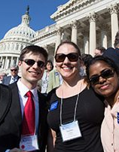
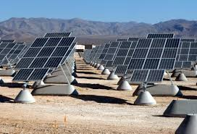
New and free initiative for educators “Beyond Doom and Gloom: Including Solutions to Climate Change.”

Slide 21
Good news:
Easy to use
Help students
High priority for climate change solutions: policies needed to transition to a clean energy future.

Slide 22
Components include:
Educator/staff page,
Student page,
Short Video and ppt slides
Short Assignments
Key Facts on Renewable Energies
Civic engagement improves learning

Slide 23
EDUCATOR/STAFF PAGE

Slide 24
Clean Energy Policies are Crucial So are Democracy Skills
Right now policies about our energy future are being made at the state and federal levels.
Many policymakers don't understand the climate change and energy policy connections. Too many are supporting damaging policies that favor fossil fuels and damage the growth of renewable energies.
Students can show up and express their desire for policies that support a rapid shift to a clean energy future.
Students are making a difference when they get involved and learning SKILLS FOR DEMOCRACY.
http://ClimateFixes.org – student webpage

Slide 25
STUDENT PAGE

Slide 26
For Students: http://ClimateFixes.org takes them to Webpage for Students http://www.aashe.org/climate-solutions/
Links to civic engagement opportunities for:
Solar Energy
Wind Power
Natural Gas is not the solution
Fixing the economy – a bipartisan price on carbon
100% renewables
Links to who to contact
Best practices for communicating with policymakers

Slide 27
Energy Civic Engagement Links
Remove Barriers to Clean Energy Growth! Click on the links below to be part of the solution:
Solar Energy
Wind Energy
Beyond Natural Gas
National Policy for Clean Energy
Solutions Project: Moving to 100% Renewables
For just this and the next slide, go to:
http://bit.ly/ClimatePolicySolutions

Slide 28
Want to contact your legislators?
Get their emails and phone numbers HERE!
You might use, “I CARE: I Care About Renewable Energies!” First used at Carleton College
(Doesn’t even mention climate change.) “Hello, my name is ____________ and I am a voter. My address is _______. I care about renewable energies and energy efficiency and want a rapid ramp up of their implementation. Please work on energy policies to make this happen. This will produce jobs, help the economy, increase health, and protect the environment. Let me know what you do." Tips for contacting your legislators:
Emails and phone calls are best.
Be brief. Stick to one issue per email/call.
Introduce yourself/include your contact info
Be polite! Anger and rudeness will not leave a favorable impression.
For this slide, go to: http://bit.ly/ClimatePolicySolutions

Slide 29
Don’t include civic engagement? It improves learning:
From US Dept. of Education funded “Sustainability Improves Student Learning” at http://SERC.carleton.edu/SISL:
Students who participate in civic engagement learn more academic content (Gallini and Moely 2003).
Civically engaged students learn higher-order skills—including critical thinking, writing, communication, mathematics, and technology—at more advanced levels of aptitude (Cress 2004).
Civic engagement increases students' emotional intelligence and motivates them toward conscientious community action (Bernacki and Jaeger 2008).

Slide 30
Components for Educators:
Short Video to share with students in class or as assignment
Motivates the students to help create solutions
Quickly educates them and links them to opportunities
Some phrases are designed for inclusion

Slide 31
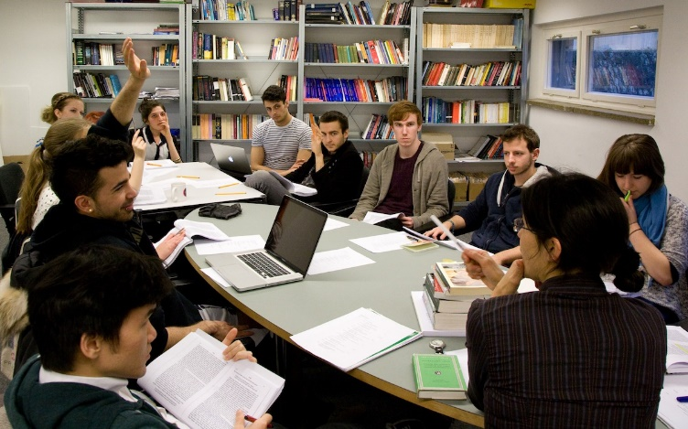
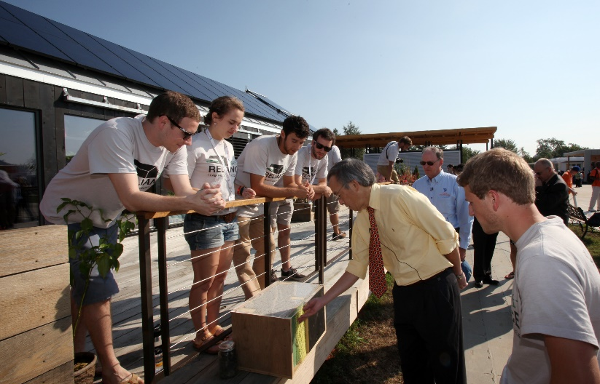
Components for educators: on faculty page
Short Assignments to be change maker: attitudes and skills.

Slide 32
Assignments Doc
Part I –Video and/or slides “Climate Solutions: Civic Engagement and Energy ”
Part II - Engagement and Reflection Assignment A quick but impactful assignment for students
Go to link (at end of video) - http://climatefixes.org
Sign up for at least two of these organizations for energy policy info/alerts.
Describe which organizations you signed up for.
Explain why you chose those organizations.
Specify what you hope to accomplish.
Part III - Multiple Choice Questions

Slide 34
Components for educators:
Key Facts on Renewable Energies
Extension of the “Call for Energy Literacy” developed with a DANS Fellow from the MIT Energy Lab

Slide 35
Key Clean Energy Facts
Right now, we have the technology to supply 80% of the electricity needs of the US with renewables and energy efficiency (EERE). From the National Renewable Energy Lab Energy Futures Analysis - http://www.nrel.gov/analysis/re_futures/
We can ramp up to 80% of our electricity needs from EERE instead of today's 15%. We already have the technologies that pay for themselves and provide lower cost.

Slide 36
Benefits of using these materials
Easy to use in any course/topic
More engaged and inspired student learning
More empowerment of students to help solve societal problems
Less frustration, worry and cynicism
A stronger democracy
A healthier economy
A healthier environment
Less disruptive climate change
Skill building for “citizenship”, critical thinking, and employment
Energy experts will keep materials updated

Slide 37
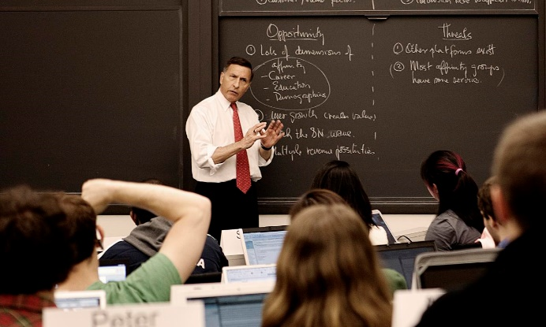
Changing what you do takes effort, but the impacts are powerful and positive!
Reduces despair and worry,
Moves us to solutions,
Provides skills for life long efforts!

Slide 38
Next Steps From This Webinar Use resources on this link: www.EarthforceResources.org/upcoming-webinars
Beyond Doom and Gloom: Climate Solutions Educator Page
Beyond Doom and Gloom: Climate Solutions Student Page
Course and Community Energy Conversations
Empowering Students With Civic Action
Key Components of Sustainability Assignments
Disciplinary Perspectives: Teaching Sustainability In…
The Shore Line Project: Become a Changemaker!
The Center for Green Schools Resources
The US Partnership K-12 and Teacher Education
Share this initiative! Contact me, Debra Rowe, at ClimateFixes@gmail.com

Slide 39
The Power of What You Do
We can choose a sustainable future
Questions/Feedback

